Slide 1
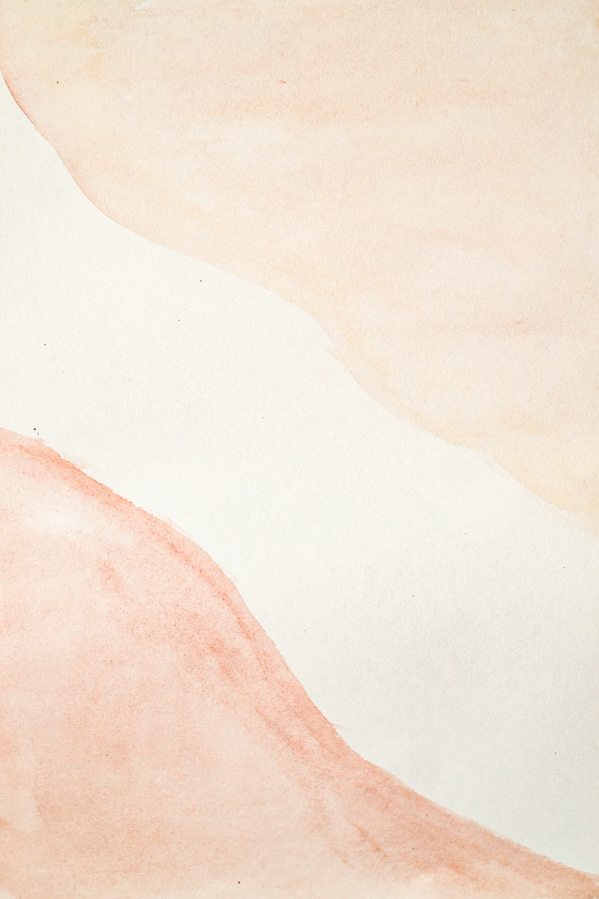

Roots of Iron
PORTFOLIO
by
Lorenzo Aristei

Slide 2
S
Roots of Iron:
My SDG Game
SDGs
When the message you want to promote is stronger than the game, it’s not a game, it’s only bad activism.

Slide 3
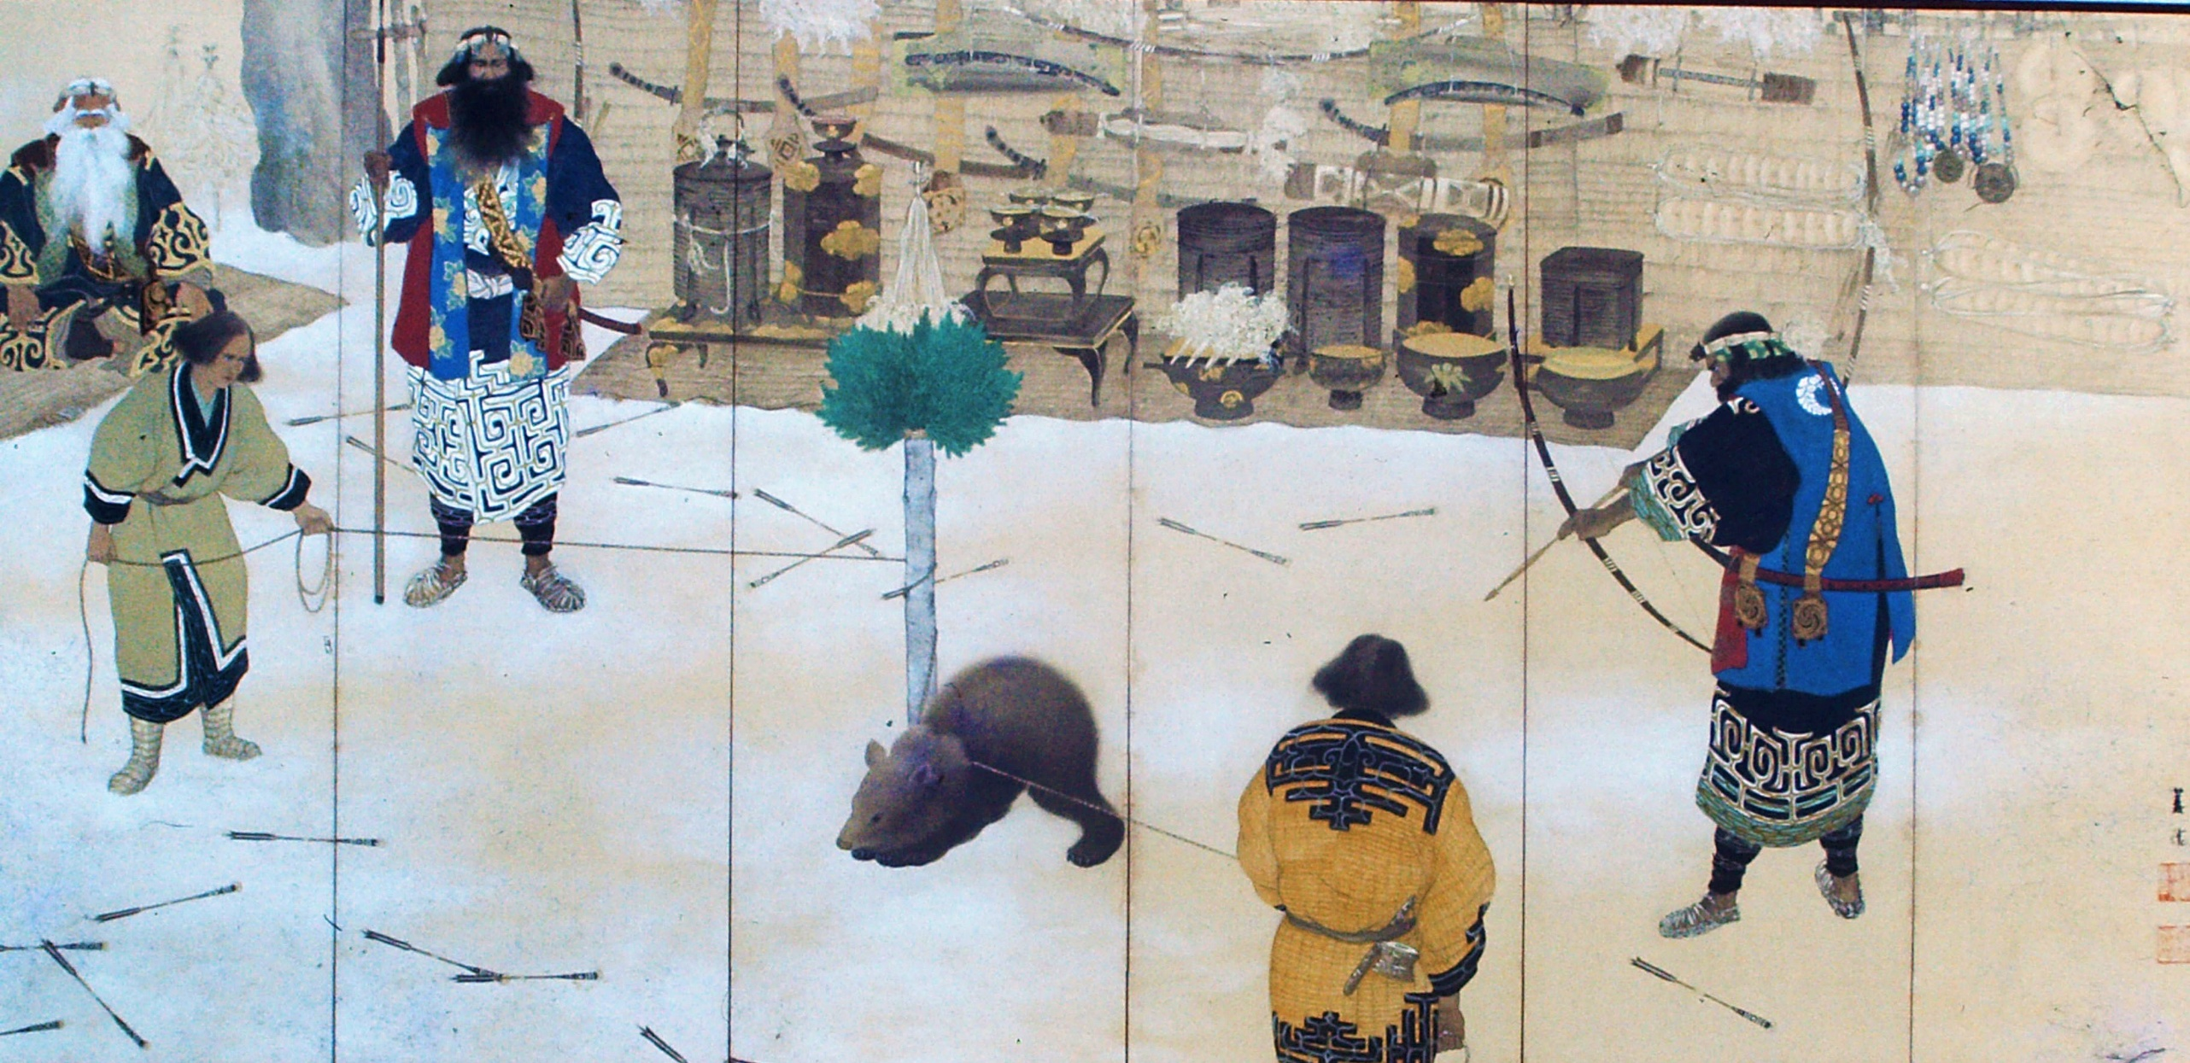
Roots of Iron:
My SDG Game
Inspiration
In a video I watched some time ago about the Tera Leak and discarded ideas from The Pokémon Company, I came across a concept inspired by Ainu folklore that really stuck with me. Later, it inspired me to create this game.

Slide 4
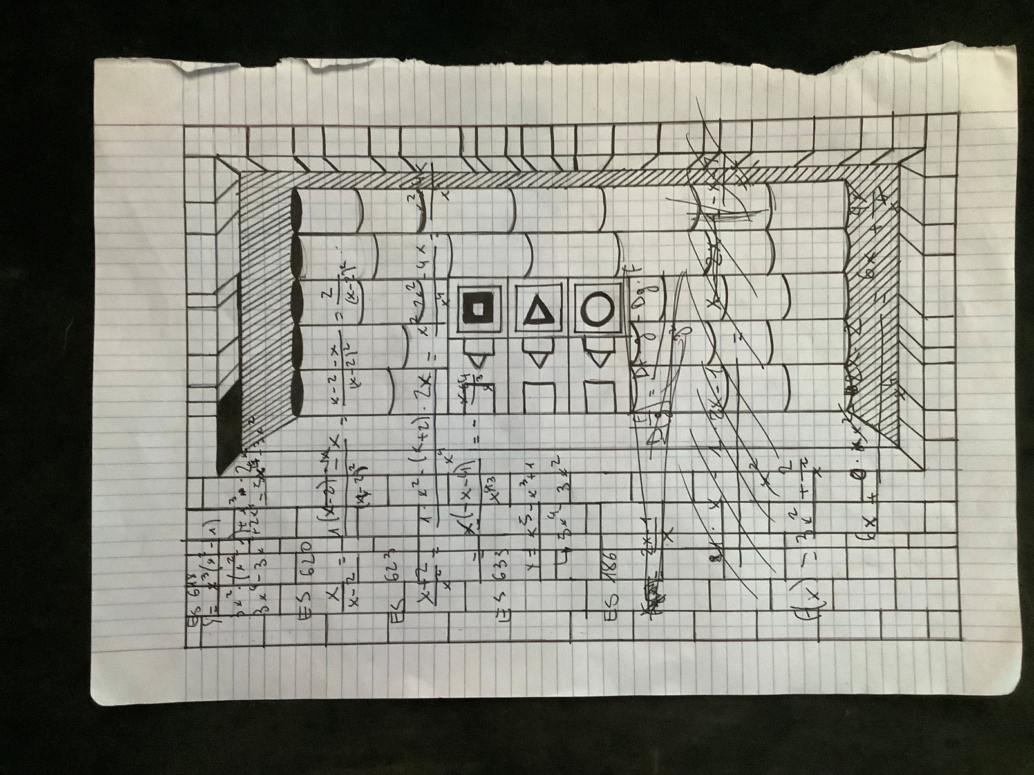
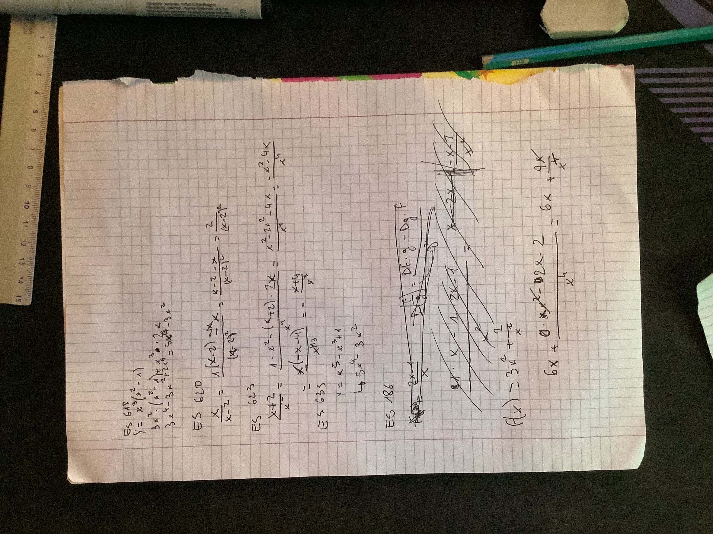
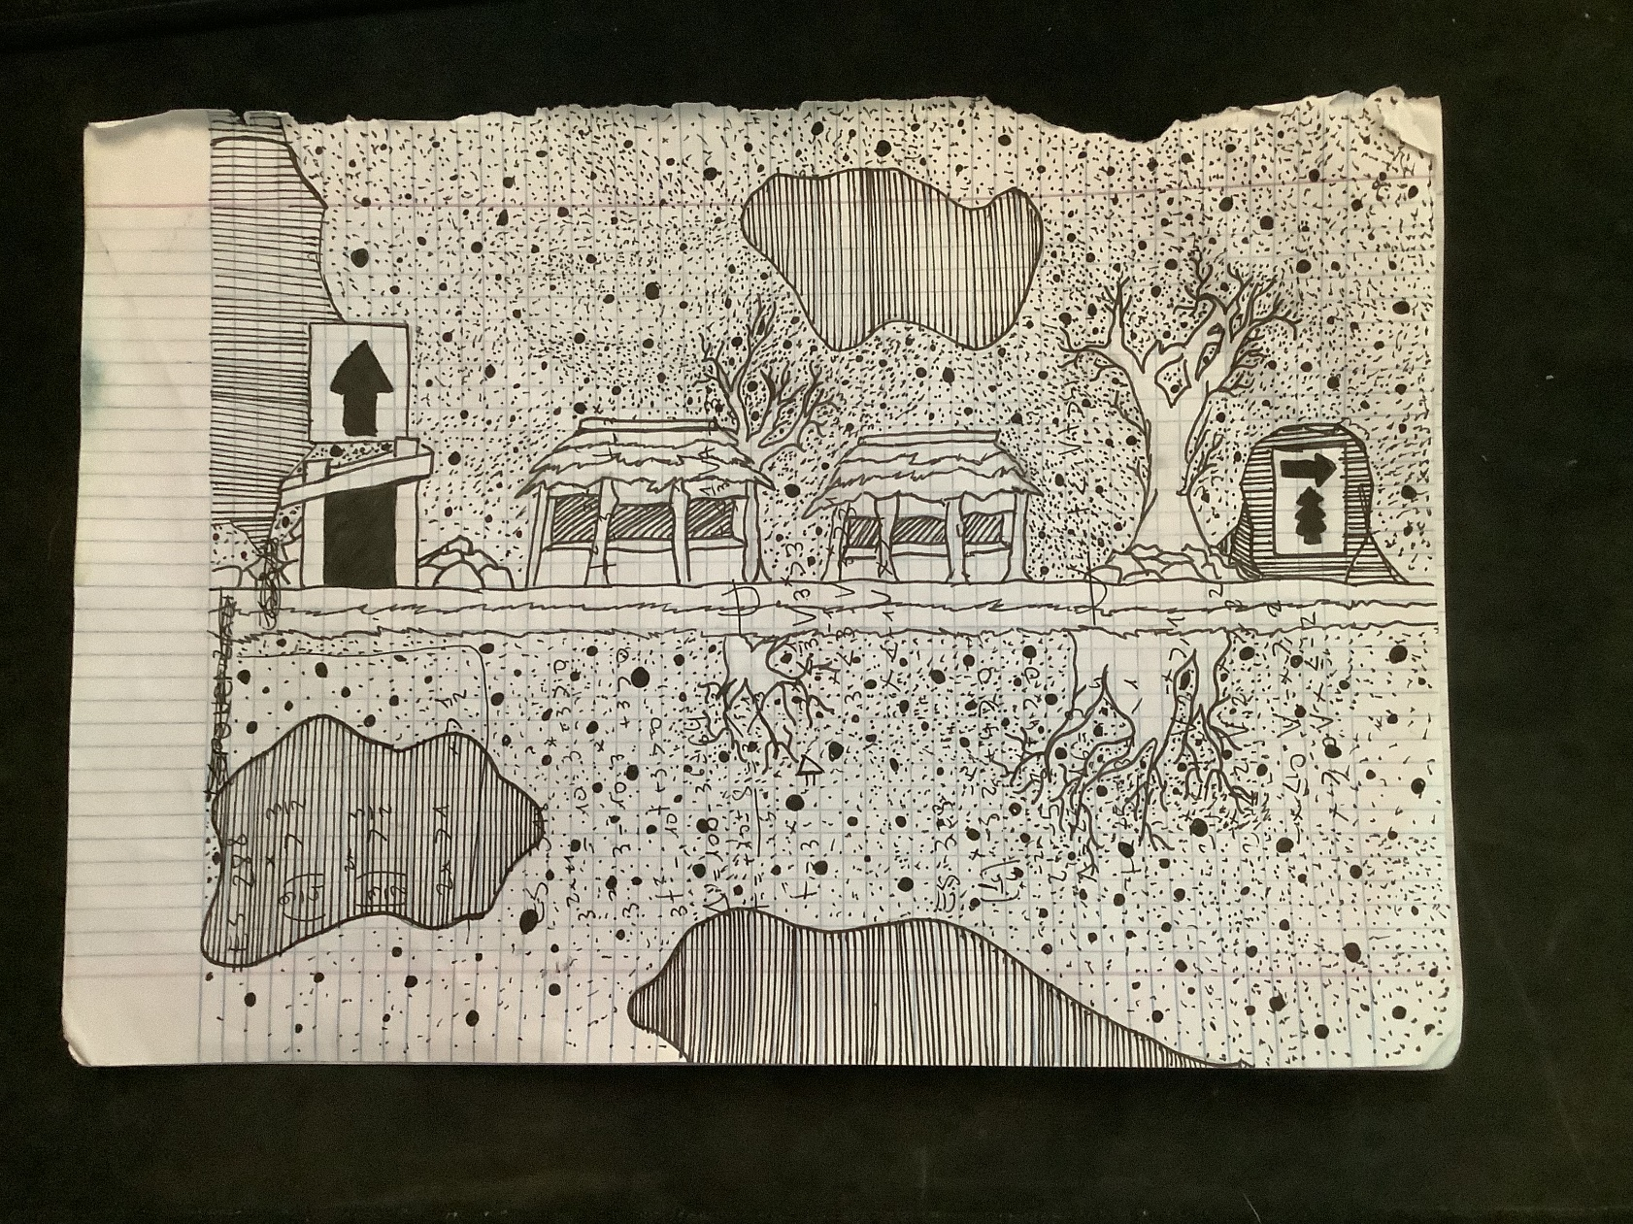
Roots of Iron:
My SDG Game
Ideas and Decision
Graphic Style
For the graphic style, I wanted something experimental that could clearly convey the message behind the game. I decided to create a visual style using already-used paper sheets, which were drawn on to create the game elements and then scanned and transferred to the computer.

Slide 5
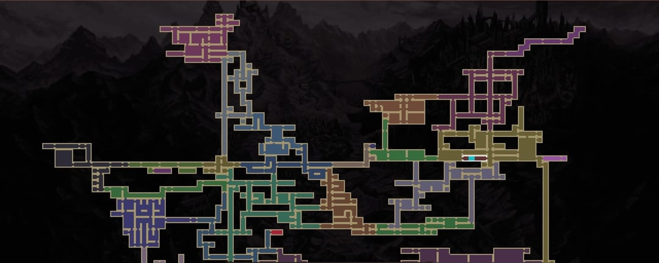
Roots of Iron:
My SDG Game
Ideas and Decision
Type of Game
For the gameplay style, I chose to adopt a metroidvania approach. Even though the game consists of only one level and does not fully explore the genre’s mechanics, my goal was to understand how this type of design works.
That’s because I am very interested in experimenting with the metroidvania genre in the future, especially exploring how it could evolve beyond traditional 2D linear spaces, potentially incorporating a sense of depth or a third dimension.

Slide 6
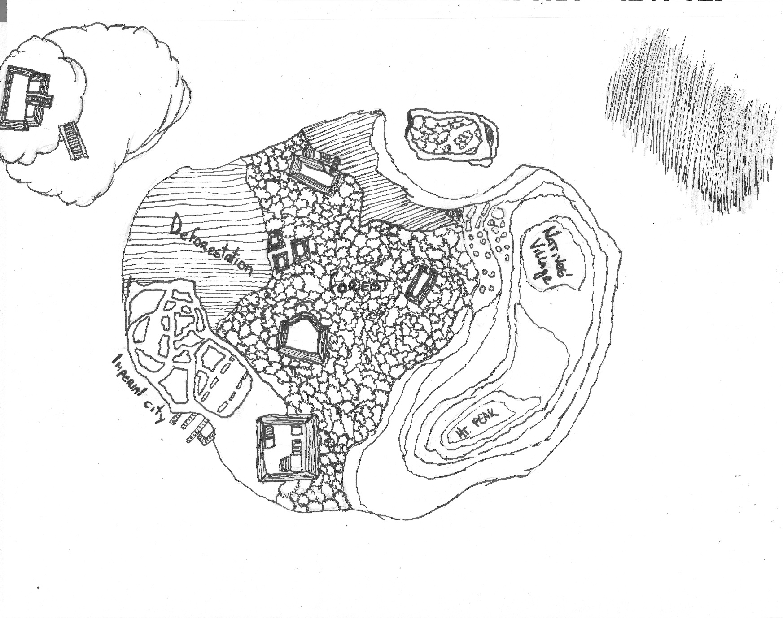
Roots of Iron:
My SDG Game
Concepts
WorldBuilding
The game map from above
The game is set in a parallel world, different from our own. A powerful Empire has risen thanks to a new technology that allowed it to conquer and dominate most of the known world, and it continues to expand. The Empire draws its power from the Sacred Islands, lands infused with a special natural energy. One of these islands is where the game takes place. Through vast machines, the Empire drains the island’s forces and transforms them into fuel for its creations, slowly unbalancing the land and everything that lives on it.

Slide 7
Roots of Iron:
My SDG Game
Concepts
Factions
The Great Empire
A theocratic power ruled by figures presented as divine interpreters. In reality, these leaders are false theocrats who disguise science as sacred magic, presenting their technology as the will of the gods. Through this belief, the Empire justifies the extraction of energy from the Sacred Islands and the destruction that follows.
The Conquered Realms
kingdoms and nations taken over by the Empire. Once independent, they are now under imperial control and used to provide land, people, and resources to support the Empire’s continued expansion.
The Island Inhabitants
The native people of the Sacred Island. They reject imperial rule and resist the occupation of their land. As the Empire advances, their villages, traditions, and lives are placed under threat, forcing them to oppose the destruction of their home and everything bound to it.

Slide 8
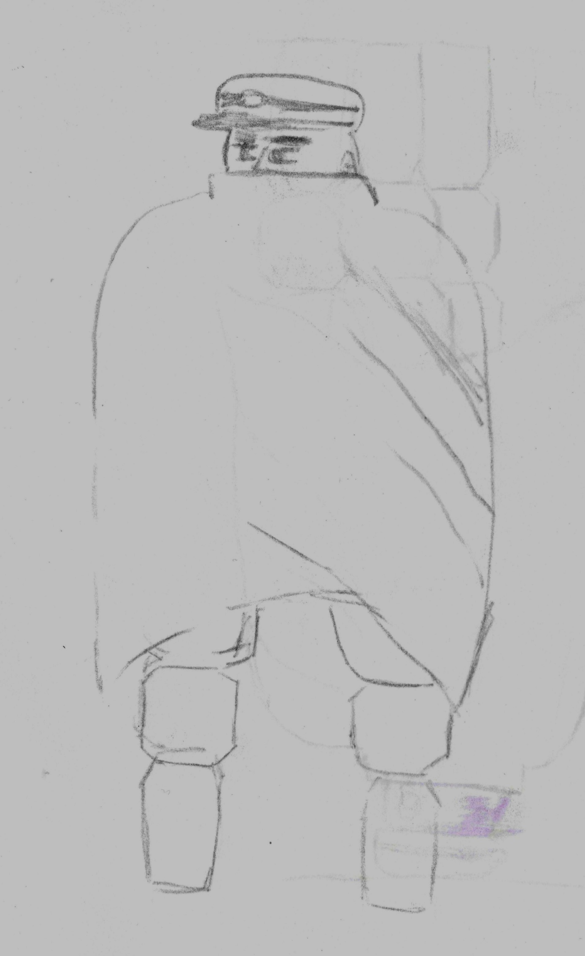
Roots of Iron:
My SDG Game
Concepts
Main Character
The protagonist was a soldier of the Empire. He joined it because he believed the Empire represented a revolution. At first, the Empire claimed to be different from the others, promising a fairer way of ruling instead of conquering without limits.Over time, he realized that the Empire was no different from the ones it defeated, and in many ways even worse. When he arrived on the Sacred Island, he understood that conquering it was wrong. He decided to turn against the Empire and side with the local people

Slide 9
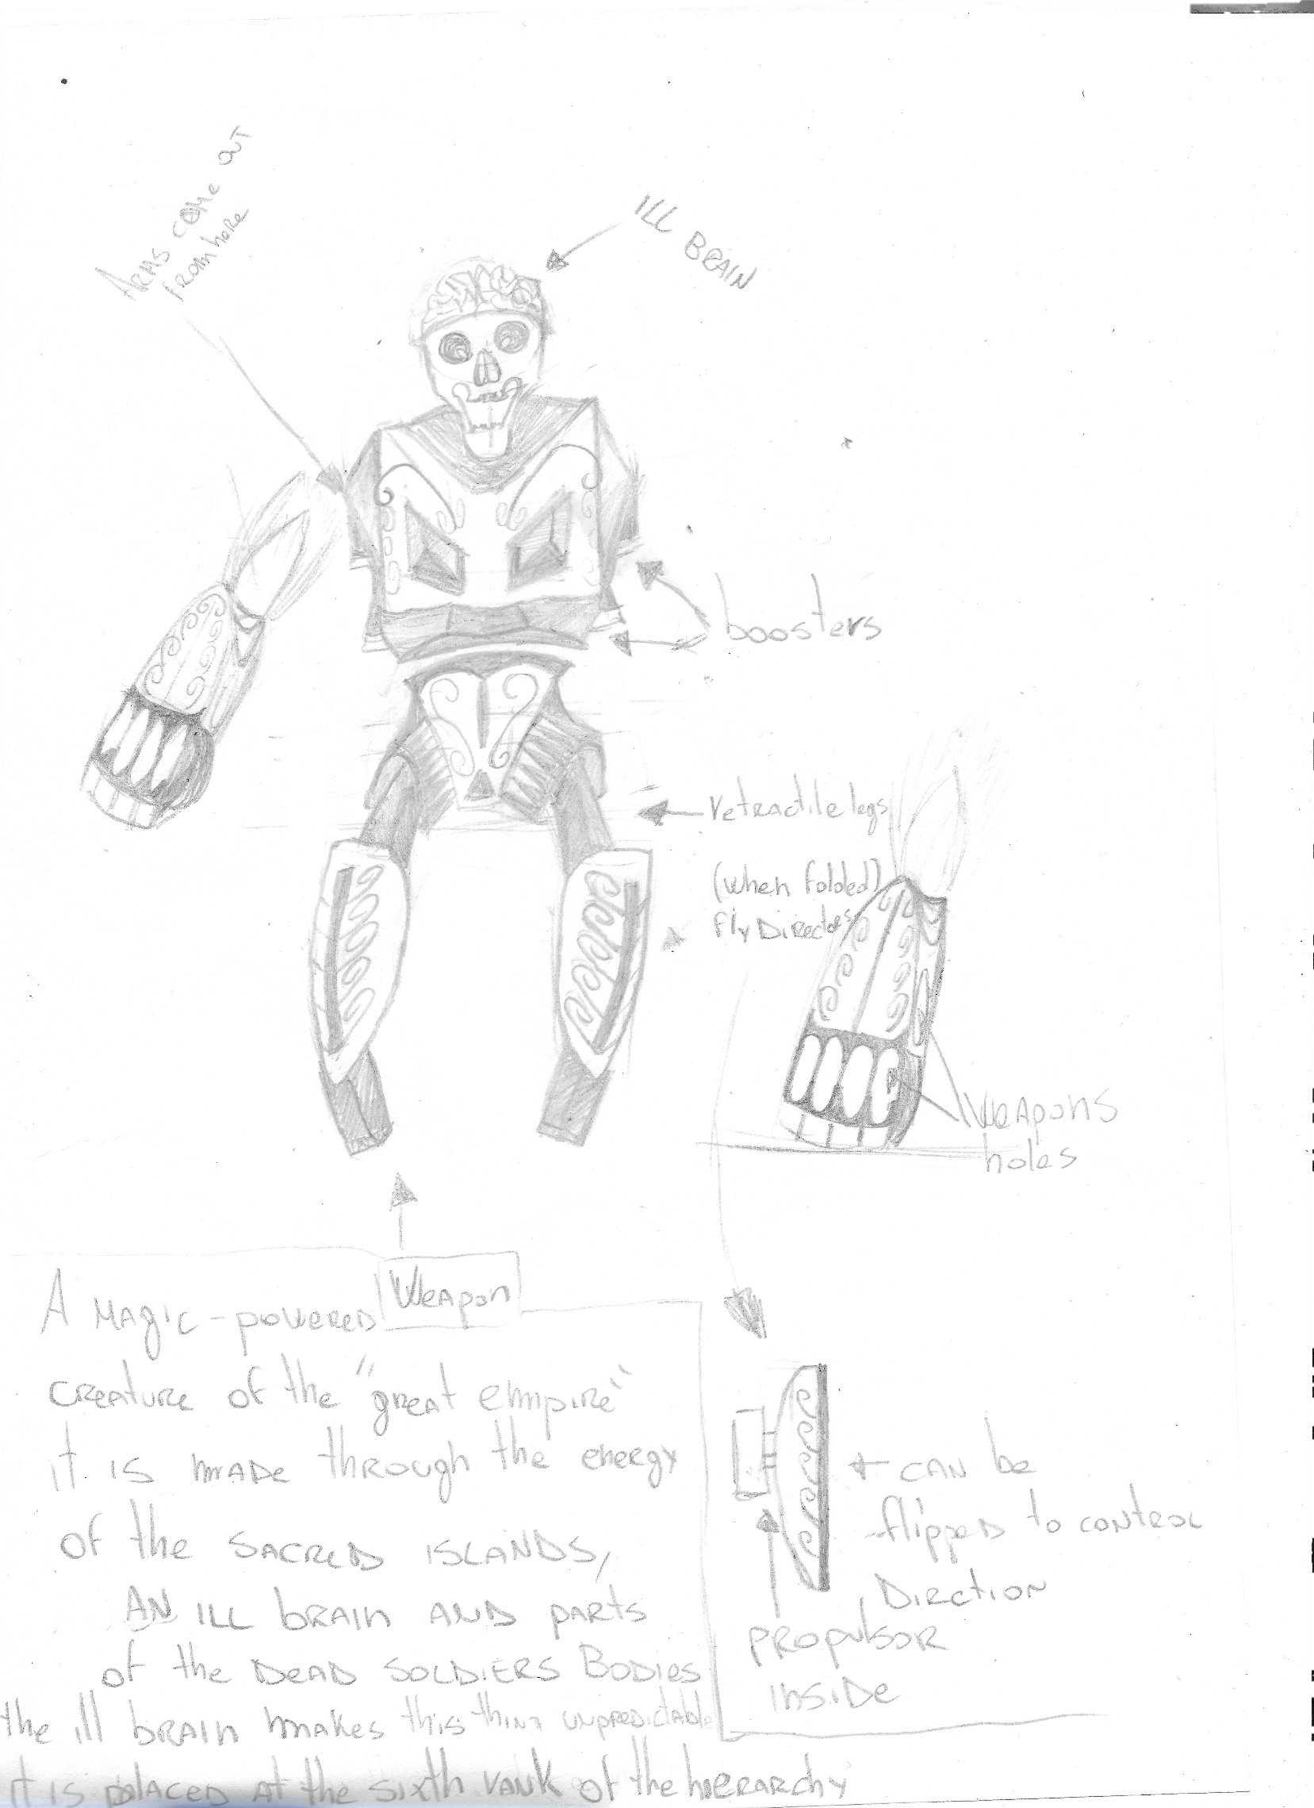





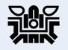


Roots of Iron:
My SDG Game
Concepts
The game is structured into three main parts. The first takes place on the island, the second happens in the ocean, and the final part occurs at the end of the game inside a dungeon flying above the clouds.
Structure
Each part features different enemy types, and every zone includes a powerful boss that is stronger than the others. The Empire’s machines are divided into ranks based on their strength. Unranked machines are the weakest, while ranked machines are divided into eight tiers. Rank One represents the highest level of power, while Rank Eight represents the lowest among the ranked enemies. Bosses belong to the highest rank.
The enemy ranks
Design of a sixth rank enemy

Slide 10
Roots of Iron:
Final Thoughts
SDGs:
I would have liked the game’s underlying message to remain more in the background.
The Visual Style:
The visual style was very rewarding because it allowed me to experiment, but it also had some drawbacks. Compared to working entirely on a PC, it required a much larger amount of additional work. Level design was also more limited, since the levels could not be made too complex. In addition, scanned photos did not represent the drawings as well as they looked in person.
The Game Type:
I would have liked to experiment more with Metroidvania elements. I am not fully satisfied with this aspect, but I chose not to push it further in order to avoid making the development too difficult.

Slide 11
Some Other Ideas
My First Try at Game Development
This is the first game I have worked on for which I managed to complete the basic structure.
In the past, I tried to work on another project, but the idea was too complex and unclear, and I struggled to understand how to implement it in a game engine.
The original concept was a game where the character could not move freely. Instead, movement was achieved by changing the level itself, which worked like a puzzle made of many small pieces. To defeat monsters and enemies, the player had to place them between two pieces of the level and separate those pieces.

Slide 12
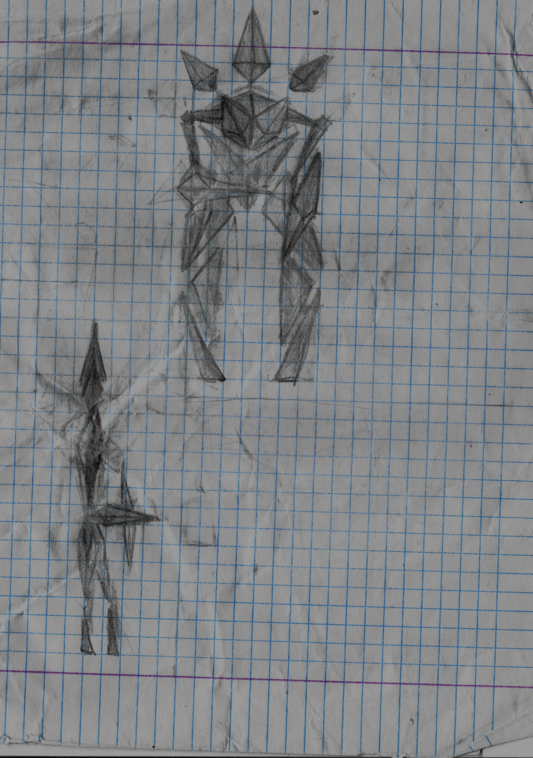
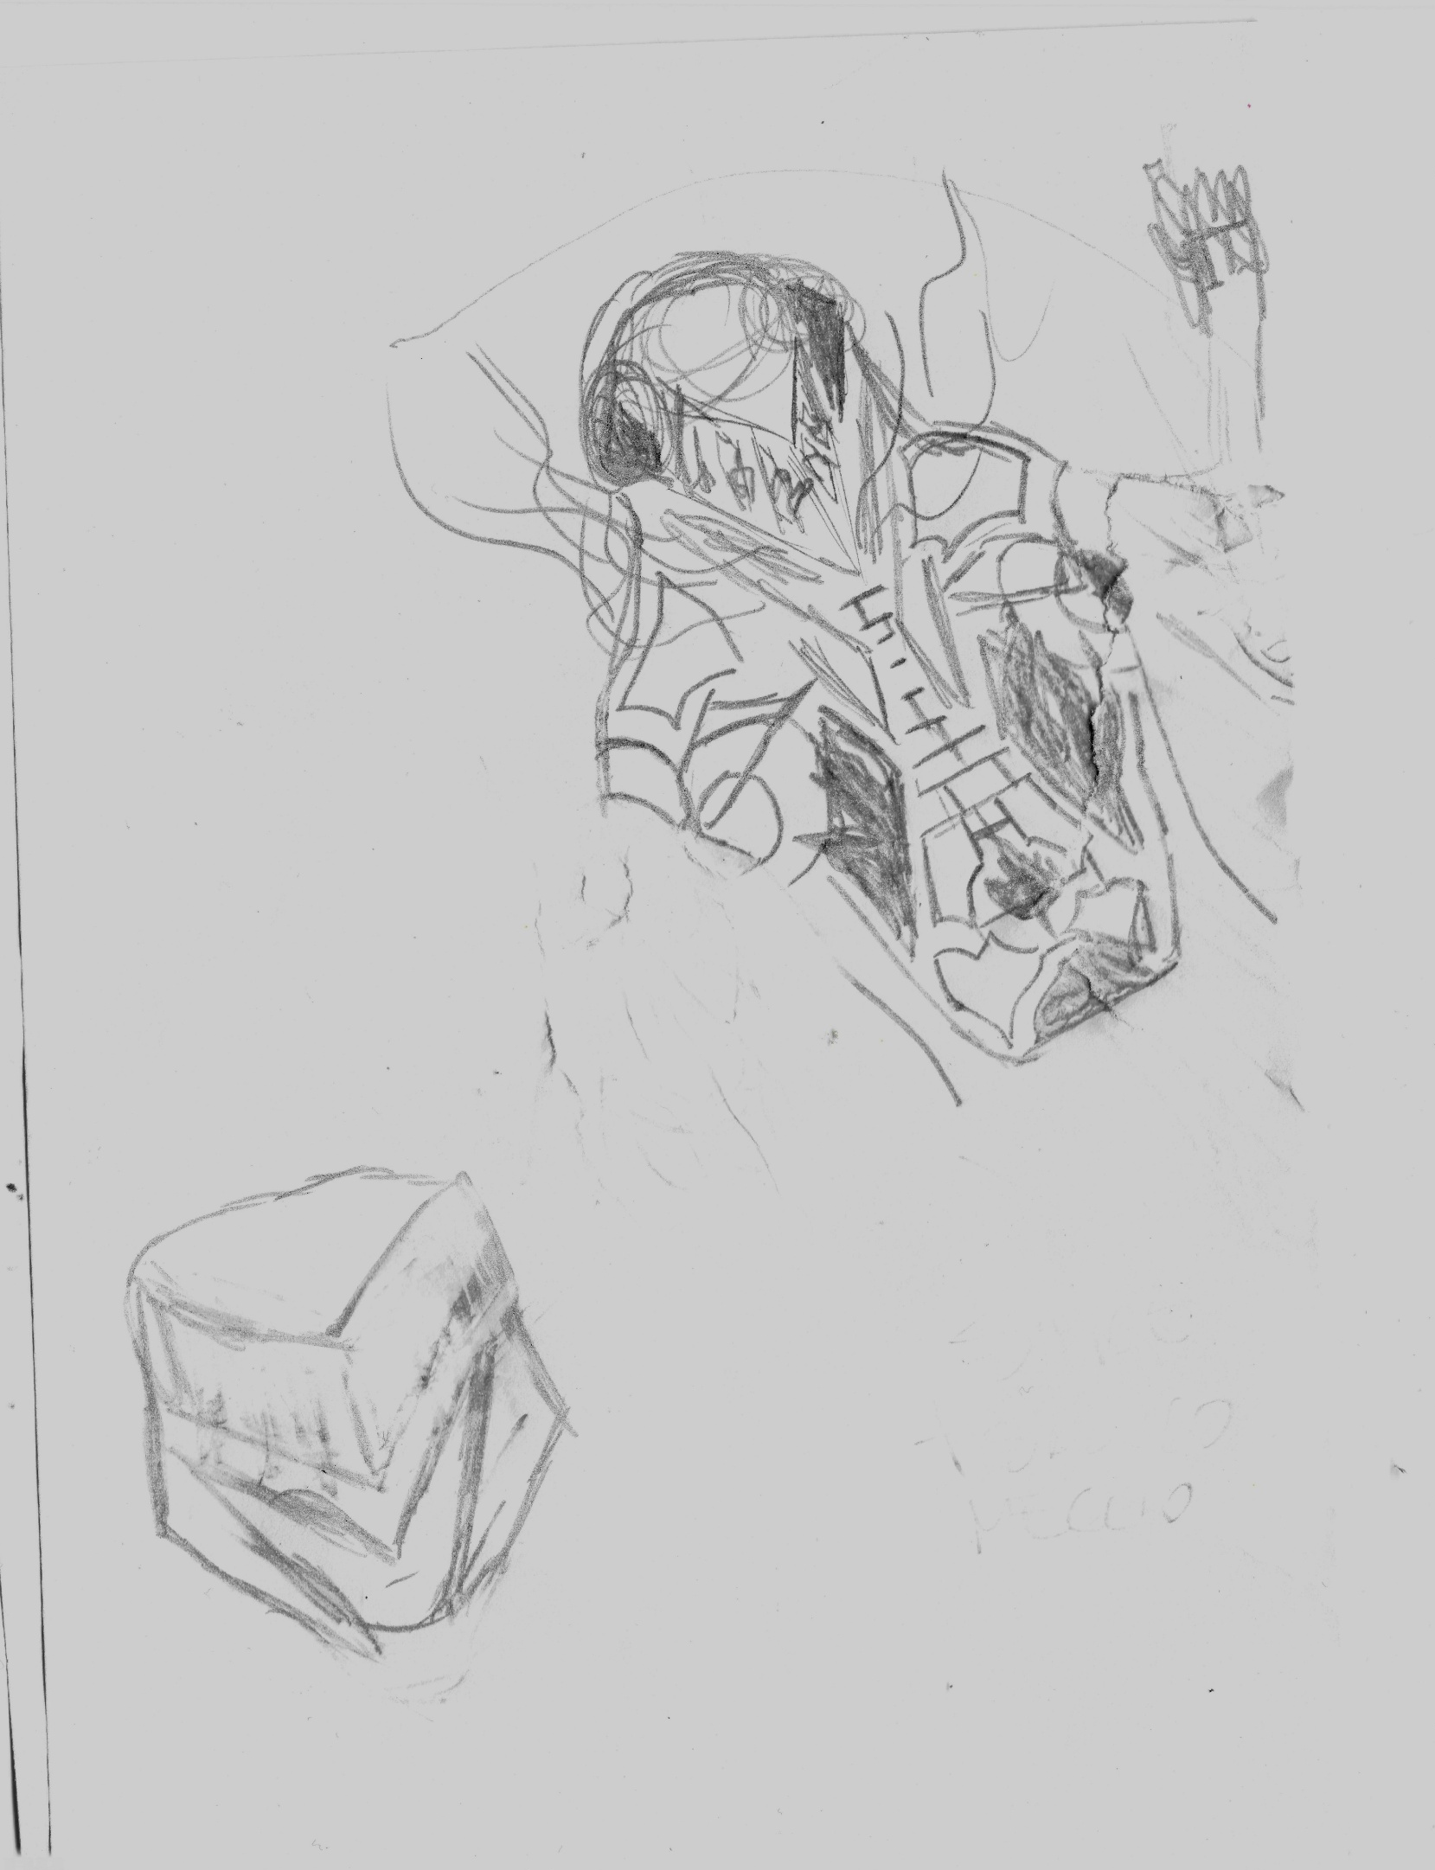
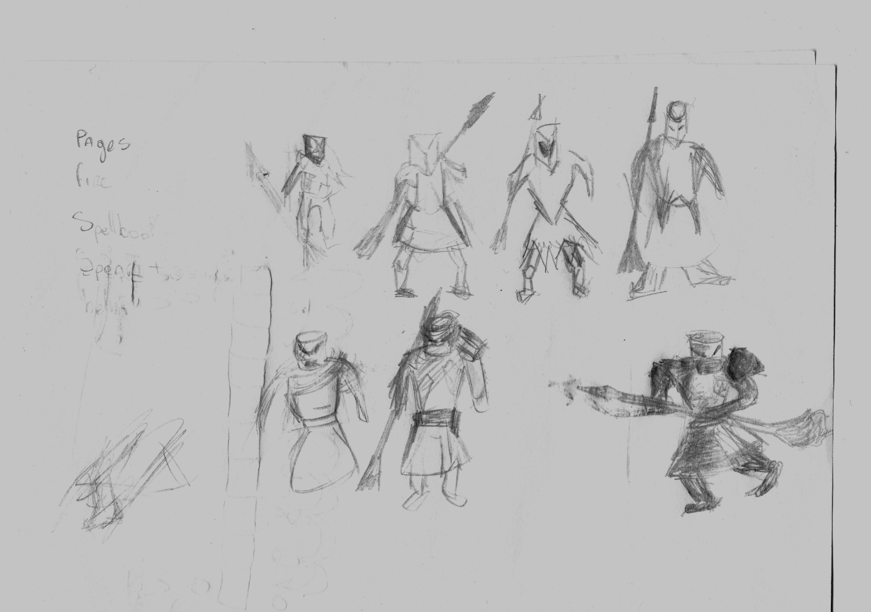
Some Other Ideas
Some Characters Ideas

